Slide 1
Building Coordinators Meeting
Friday March 28th, 2025

Slide 2
Facilitator
Kelly Ore ,
Preventive Maintenance Coordinator UNM Facilities Management
kore@unm.edu

Slide 3
Meeting Process
Please use raise hand feature or the chat to ask questions
We’ll address questions when the primary speaker is finished.

Slide 4
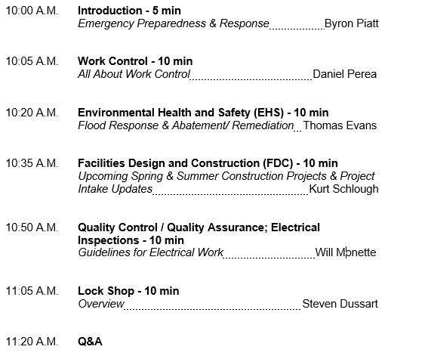
Agenda

Slide 5
Welcome
Byron Piatt
Director, Crisis Management & Preparedness
BPiatt@salud.unm.edu
Office: 505-934-5588

Slide 6
All About Work Control
Daniel Perea
Work Control Manager, Facilities Management
dperea1@unm.edu
Office: 505-277-4842

Slide 7
All About Work Control
What is Work Control
Work Control is at the forefront of Facilities Management.
We process 58,000+ work orders annually for the UNM community and some branch campuses. Working on anything from Air Conditioners to Water Coolers and everything in between.
Work Control is not just maintenance. We also assist when people are new (or seasoned Lobos) lost on campus, or when you just aren’t sure who to contact. We offer many resources to help out when and where it is needed.

Slide 8
All About Work Control
The Life of Your Work Order
Work Requests may be submitted via iservicedesk.unm.edu, by email, or by calling Work Control at 505-277-1600.
Once your request has been received, a Service Call Coordinator will create the Work Order for you and dispatch it to the correct Repair Center.
Managers/Supervisors in the Repair Center will schedule your work order to a Technician for completion.
For work order inquiries and updates, or billing questions, please contact Work Control at 505-277-1600. We are always happy to assist you with your questions/concerns.

Slide 9
All About Work Control
Tips & Tricks for Successful Submissions
Always give as much information as possible about your issue or concern with your building. The location of the issue. If no room number is available, please list the nearest room.
Ensure that your contact information is correct in case we need to contact you regarding your work order.
The INDEX field on the iservicedesk request page is now mandatory. Providing your index does not mean your department will be charged for the repair. Work Control knows which buildings are 100% I&G and which buildings are less than 100%. The description of the work requested in your submission also helps to determine whether the cost will be covered by FM or if there will be a cost to your department. Facilities Management will always communicate the cost of any repair to you before charging your index.
Remember not to submit for multiple Trades in 1 request. (i.e., an electrical issue and a plumbing issue)

Slide 10
All About Work Control
Examples of Normal Building Maintenance vs. Paid Work
Normal Building Maintenance is for issues like:
Stopped up restrooms
Light bulbs out
Door locks no longer functioning
Electricity has gone out
Day to day Custodial duties
No hot water/no water
Paid Work is for issues like:
Hanging a whiteboard, framed artwork, repainting your office, etc.
Any events where tables, chairs, or other equipment are needed from Special Activities or removal of refrigerators or moving your office.
Special Recycling purge projects
Any requests for the FM Sign Shop
Any issue above and beyond normal routine maintenance

Slide 11
All About Work Control
Elevators, Elevators, Elevators
Elevators prove to be one of Work Control’s challenges. We need assistance from all of you to make sure we have the correct elevator unit information so we may have the elevator corrected in the timeliest manner possible, especially in an entrapment situation.
All elevator units have 2 identity tags. 1 inside the elevator and 1 outside of the elevator. These identity stickers are at the top of the elevator door frame. They are white with black letters and will have a number. (i.e., A0200-1-E1) The beginning of the number is your building number. The ending number of E1, E2, etc., is the elevator unit number. This is how KONE Elevator responds to the correct unit. Simply putting the NE side or S side of the building, or a double unit on the Left side, doesn’t assist us with identifying the proper elevator to call in. *Please get that elevator number before calling or submitting a ticket.*
If your elevator is missing the identity tag, please let us know so we can have KONE Elevator replace that for you.

Slide 12
All About Work Control
What DON’T We Do?
Work Control does not process or create work requests for the following Areas:
Alarms – help.unm.edu or 505-277-1140
Main IT – help.unm.edu or 505-277-5757
UNMH – 505-272-2500
Automotive – automotive@unm.edu or 505-277-3670.
Environmental Health & Safety (EHS) 505-277-2753
Parking & Transportation Services (PATS) 505-277-1938
Finance, Design, & Construction (FDC) - fdc.unm.edu or 505-277-3600

Slide 13
All About Work Control
Questions & Answers
You have questions. We have answers.

Slide 14
All About Work Control
Work Control Contact Information
Work Control Mainline - 505-277-1600
Daniel Perea – Manager of Work Control
505-277-4872
dperea1@unm.edu
Kristina Rucker – Lead Service Call Coordinator
505-925-9516
ruckerk@unm.edu
Zach Case – Service Call Coordinator
505-925-9627
zcase@unm.edu
Arianna Myers – Service Call Coordinator
amyers970046467@unm.edu

Slide 15
Flood Response and Abatement/ Remediation
Thomas “Tommy” Evans
Council-certified Indoor Environmentalist, Safety Specialist,
Environmental Health and Safety
tevans5@unm.edu
Office: 505-277-1692

Slide 16
Flood Response and Abatement/ Remediation
Notify Facilities Management
FM notifies EHS – Duty officer pager (505-951-0194) or call Tommy Evans directly
EHS and FM review asbestos records
If no records exist, affected materials must be sampled or assumed to be ACM
FM or EHS will coordinate abatement/remediation

Slide 17
Flood Response and Abatement/ Remediation
Contractor Responsibilities
Extract the water
Set up fans and dehumidifiers, as appropriate
** They must not remove carpet, cove base, ceiling tiles, or cut any walls until the materials are confirmed as non-ACM.

Slide 18
Flood Response and Abatement/ Remediation
Building Materials to Check
Flooring materials
Carpet mastic
Vinyl floor tile/mastic
Linoleum
Ceiling Tiles
Lay-in ceiling tiles
Glued-on ceiling tiles with mastic
Cove base mastic
Wall materials
Drywall (texture and joint compound)
Plaster (surface coat, skim coat, scratch coat)
CMU block – surface compound

Slide 19
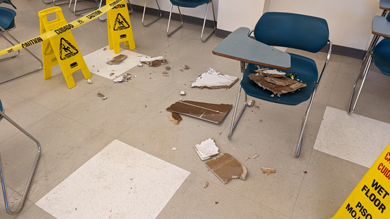
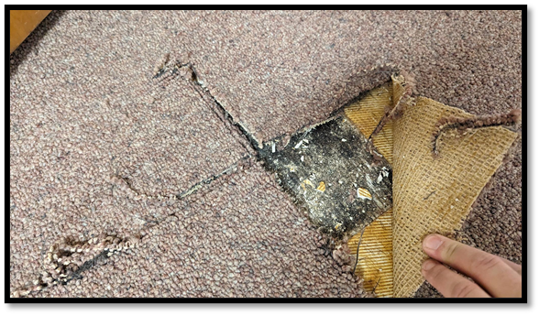
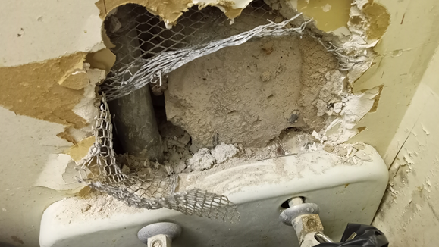
Flood Response and Abatement/ Remediation
What to look for.
Continued …

Slide 20
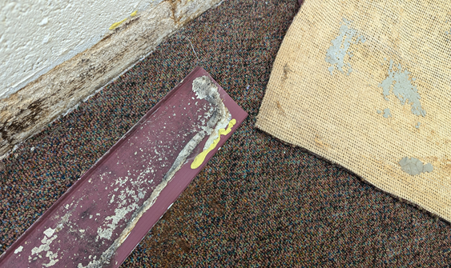
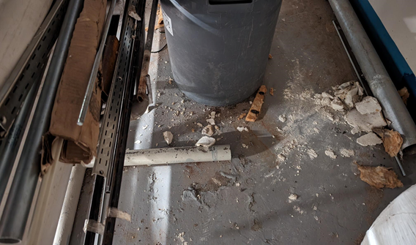
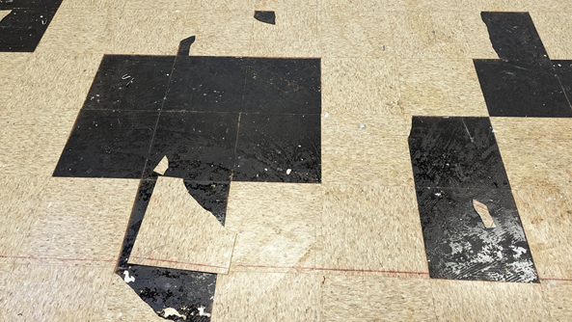
Flood Response and Abatement/ Remediation
What to look for.

Slide 21
Upcoming Spring & Summer Construction Projects & Project Intake Updates
Kurt Schlough
Director, Facilities Design & Construction
kurts@unm.edu
Office: 504-957-6337

Slide 22
Upcoming Spring & Summer Construction Projects

Slide 23
Project Intake Updates
Scoping Fee Notification
For every Facilities Design & Construction scope statement completed and signed, a $1,000 estimate authorization fee will be applied to the project. As FDC is a fee based department, this fee ensures thorough and accurate project scoping. If the project proceeds past the scoping stage, this fee will be reimbursed to the project.

Slide 24
Project Intake Updates
Anticipated Additional Fees
If the project proceeds, the following fees may be required:
Hazardous Materials Testing:
If the project includes the renovation of an existing space, or the attachment of new materials to existing materials within an existing space, the existing materials must be tested for hazardous components prior to disturbing the existing materials. If UNM EHS does not have archived test results for the material in the existing area to be renovated, hazardous material testing will be required.
Depending on the scale of the project, a minimum testing fee of approximately $800 should be anticipated.

Slide 25
Project Intake Updates
Anticipated Additional Fees
Hazardous Material Removal:
Through testing, if hazardous material, such as asbestos, is found in any of the existing building materials to be removed or disturbed, per UNM Environmental Health & Safety guidelines, the confirmed hazardous materials must be remediated and removed per NIOSH requirements.
Depending on the scale of the project, a minimum remediation fee of approximately $3,000 should be anticipated.

Slide 26
Project Intake Updates
Anticipated Additional Fees
Architectural or Engineered Drawings:
If the project requires the revision and/or addition of any of the following, a set of Architectural and/or Engineered construction drawings, stamped by a NM licensed professional (as required by the NM State CID Permitting Authority) will be required:
Fire Egress pathway revisions
Fire Alarm Device revisions
Occupancy requirements for an existing space
Mechanical (Heating, Ventilation, Air Conditioning) System revisions
Electrical System revisions
Plumbing System revisions
Structural revisions
Site Drainage revisions Depending on the scale of the project, a minimum stamped construction document preparation fee of $3,500 should be anticipated.
Depending on the scale of the project, a minimum stamped construction document preparation fee of $3,500 should be anticipated.

Slide 27
Project Intake Updates
Anticipated Additional Fees
Lab Safety Standards:
All lab projects go to the UNM Lab Safety Review Team for review of facility requirements. The team reviews the proposed activity and determines the safety level and any other special needs for the space to be safely operated. The determination is given to the project manager and the E&ES representative provides oversight of the design.
Lab project costs related to additional architectural, mechanical, electrical, or plumbing requirements as determined by the Lab Safety Review Team will be assessed on a case by case basis.

Slide 28
Electrical Work Guidelines
Will Monette
Electrical QAQC Specialist ,
Facilities Management- Engineering
wmonette@unm.edu
Office: 505-321-5612

Slide 29
Electrical Work Guidelines
QAQC Roles & Responsibilities
Supports University-wide engineering and maintenance activities involving new construction, maintenance, repair, and renewal of electrical system operations.
Ensures compliance with safety requirements, specifications, applicable codes, and engineering standards.
Serves as the Qualifying Party for all associated University licensing and permitting in the EE9J, EE98, EL1J, & EL1 classifications.

Slide 30
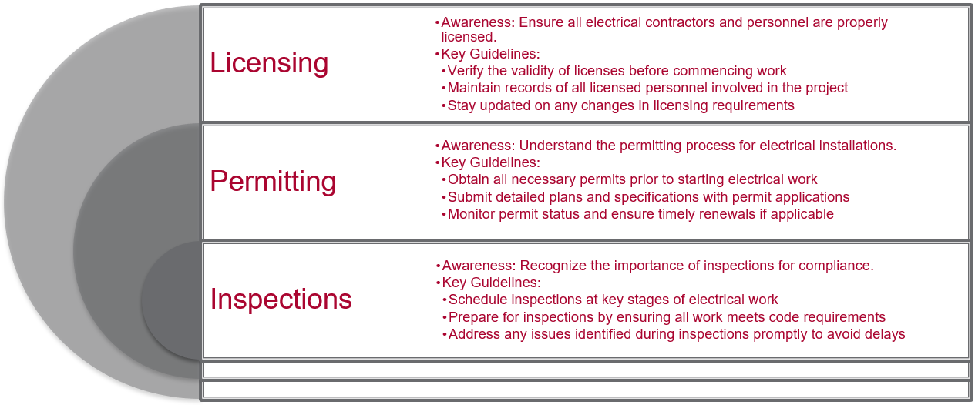
Objective

Slide 31
Electrical Work Guidelines
Contractor Requirements
All electrical contractors working at UNM must have the following:
Have provided a copy of their company safety plan to UNM’s Environmental Health & Safety department.
NM electrical contractor’s license.
NM journeyman license in the applicable classification.
Applicable electrical permit(s). All electrical work performed at UNM requires a State of New Mexico, Construction Industries Division (CID) permit.
Electrical work performed under issued permit must be inspected by CID and UNM.
Final invoices submitted to UNM for payment must be accompanied by one of the following:
Copy of CID tag(blue/green) showing final inspection passed.
Electrical permit signed by CID electrical inspector.
Email notification from CID showing inspection results.
Appropriate insurance and bonding capacity for the value of the work, if over $25,000.
Posted wage rates if the project cost is over $60,000.
Proper Personal Protective Gear (see NFPA 70-E).

Slide 32
Electrical Work Guidelines
Licensing

Slide 33
Electrical Work Guidelines
Permitting & Inspections

Slide 34
Electrical Work Guidelines
Helpful Links
1. Construction Industries Division https://www.rld.nm.gov/construction-industries/rules-laws-and-building-codes/
2. UNM Facilities Management https://fm.unm.edu/
3. UNM Standards and Guidelines https://fm.unm.edu/standards--guidelines/index.html
4. UNM Electrical Specifications for small projects https://fm.unm.edu/assets/documents/electrical-specifications.pdf
5. UNM Design Standards https://fm.unm.edu/assets/documents/design-standards.pdf
6. UNM Environmental Health and Safety https://ehs.unm.edu/
7. UNM EHS Standards and Guidelines https://ehs.unm.edu/ehs-standards-and-guidelines.html
8. UNM EHS Construction Safety https://ehs.unm.edu/construction-safety/index.html
9. UNM Electrical Safety Program https://ehs.unm.edu/assets/documents/sop-copies/electrical-safety-program1.pdf

Slide 35
Lock Shop Overview
Steven Dussart
Manager,
Lock Shop
sdussart@unm.edu
Cell: 505-362-3932

Slide 36
Lock Shop Overview

Slide 37
Lock Shop Overview

Slide 38
Lock Shop Overview

Slide 39
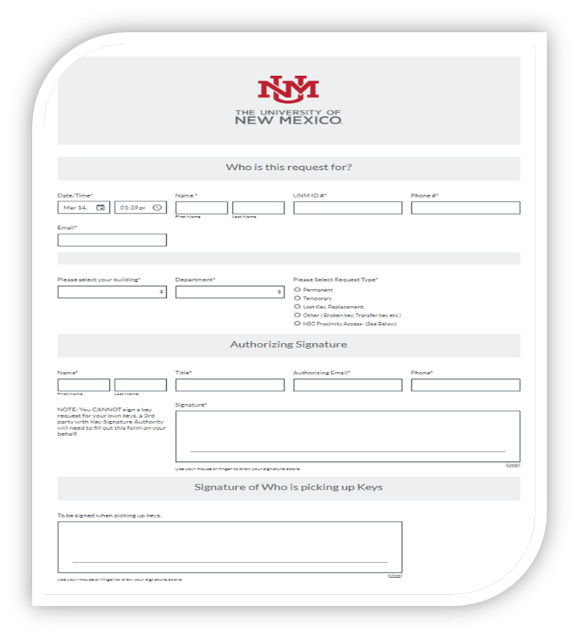
Lock Shop Overview
Remote Key Request

Slide 40
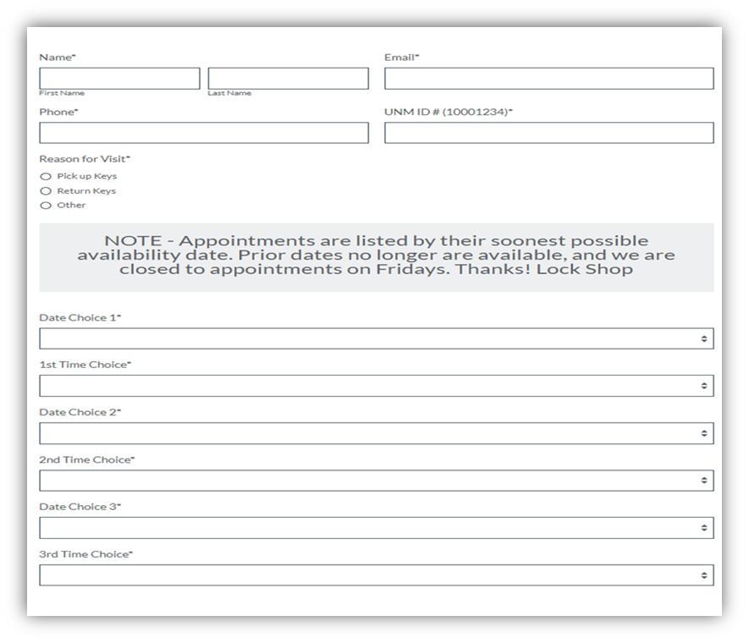
Lock Shop Overview
Appointment Scheduling

Slide 41
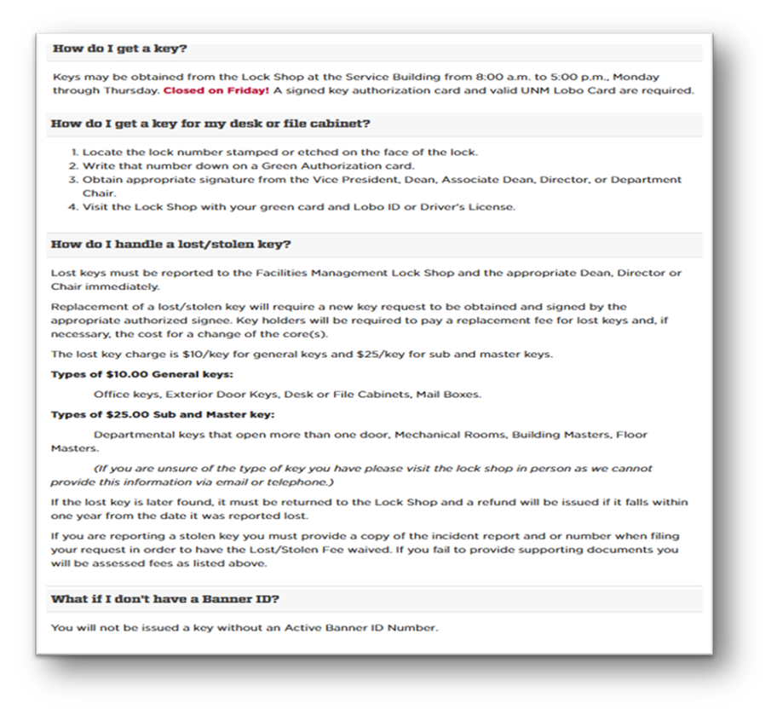
Lock Shop Overview
FAQ’s

Slide 42
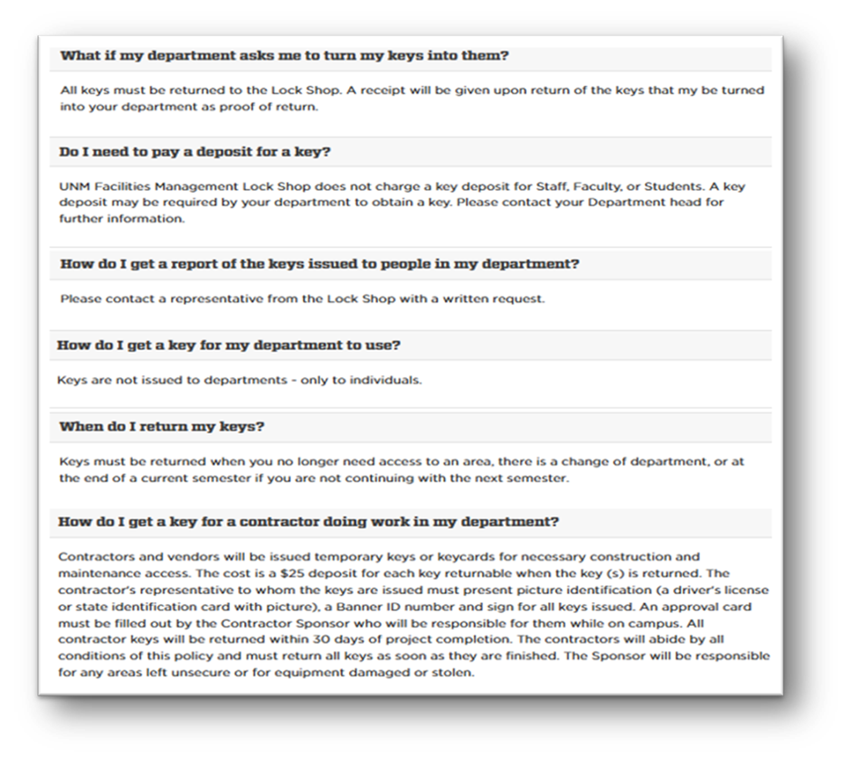
Lock Shop Overview
FAQ’s

Slide 43
General Questions
The floor is open for questions or topics not yet covered

